Slide 1
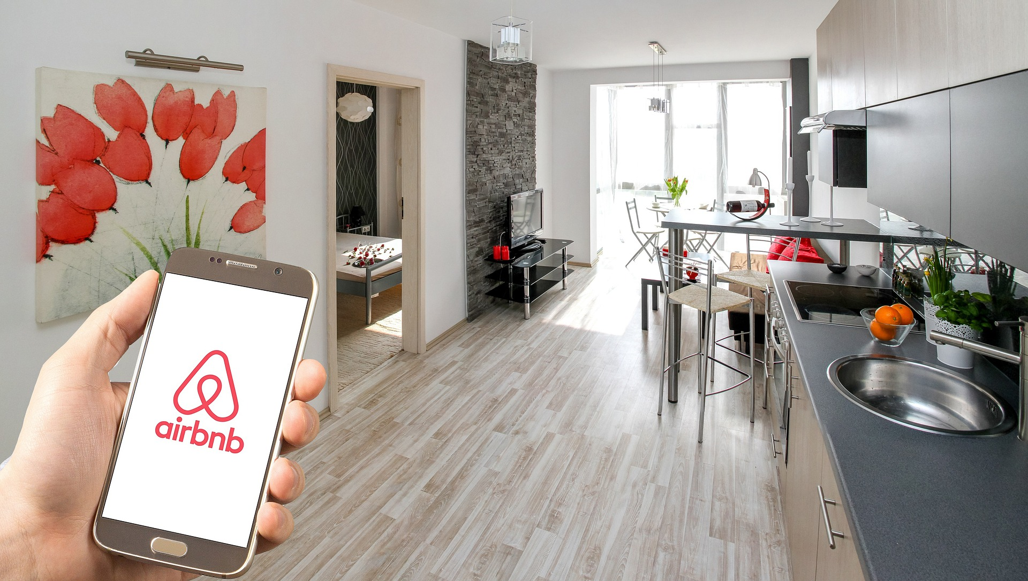

REAL ESTATE INVESTMENT FOR AIRBNB RENTAL
AirBnB Data Analysis of New York Area to determine future investments

Slide 2
AGENDA TOPICS
Who are we?
Goal
Analysis
Results

Slide 3
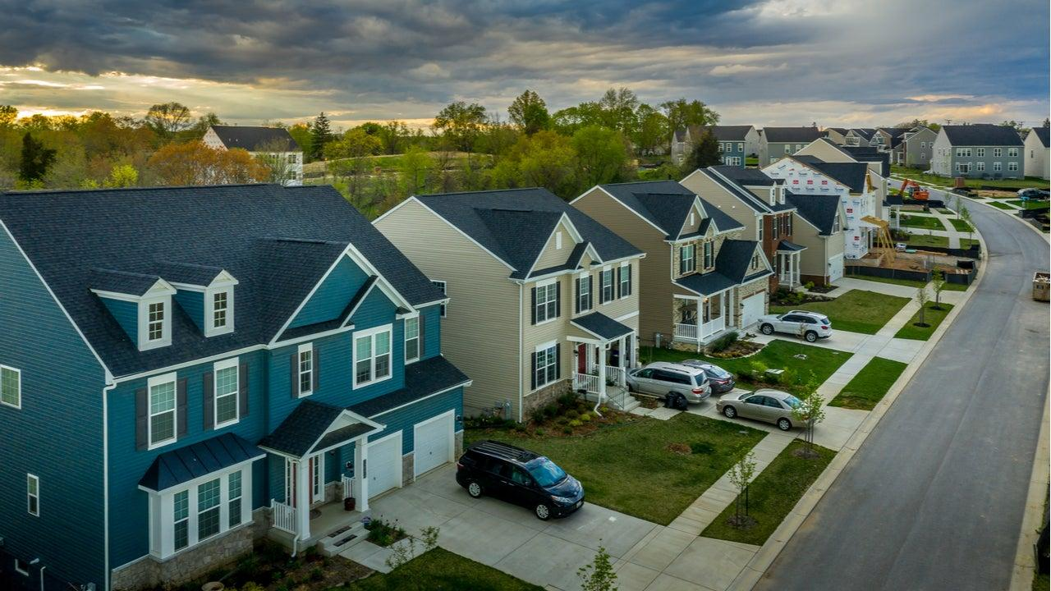
1. Who we are?
Analysts:
Dimitrios Thymioudis, Data Scientist
Nikolaos Christoforou, Data Scientist

Slide 4

2. Goal
Dream Home Real Estate, ltd
A company that is interested in investing in Real Estate to use them for AirBnB Rental Services
Data Analysis Project
New York City
Factors that influence rental prices and attractiveness
Propose future investment for the company

Slide 5


3. Analysis (1/4) - Data Source
Data Exploration
Open data from Airbnb Open Data (New York Airbnb Open Data)
Listings, including full descriptions and average review score.
Reviews, including unique ID for each reviewer and detailed comments
Calendar, including listing id and the price and availability for that day

Slide 6
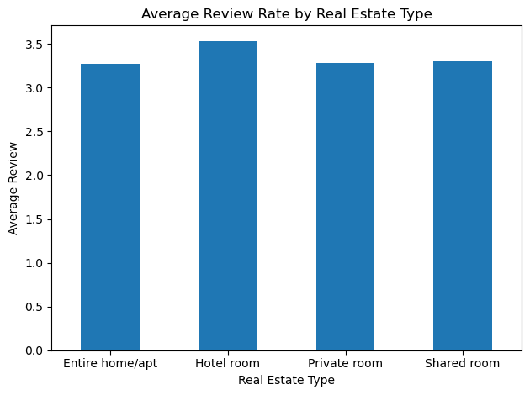
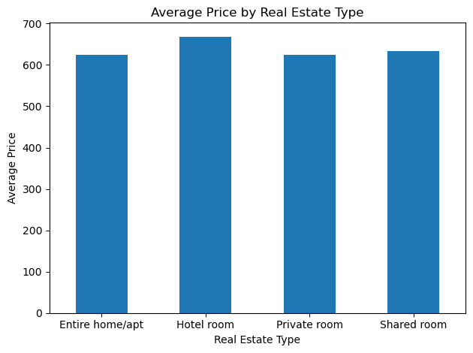
3. Analysis (2/4) - Type of Real Estate
Insights:
Real Estate Type has the same impact on Ratings & Price.
Hotel Rooms have slightly higher average pricing.

Slide 7
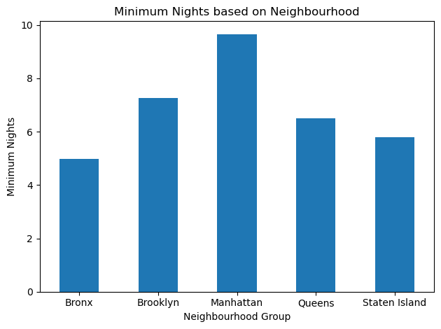
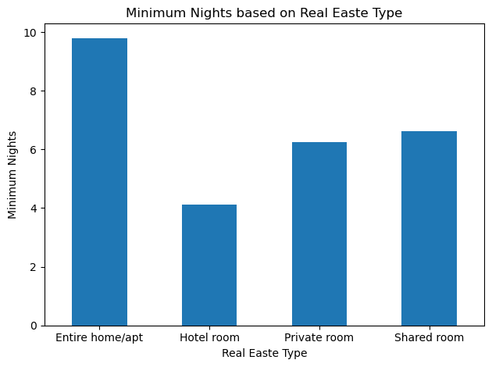
3. Analysis (3/4) - Minimum nights reservation
Insights:
Manhattan is most likely to be picked for longer rental time
Hotel rooms are less likely to be picked for longer rental time
Hotel average price is slightly higher that Entire home/apt but the long term profit is bigger on Entire home/Apt.

Slide 8
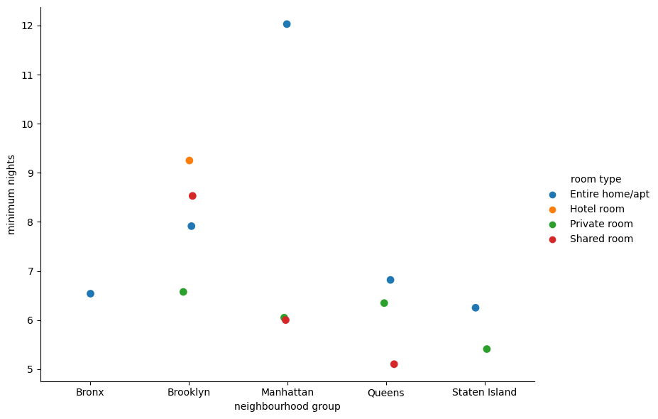
3. Analysis (4/4) - Minimum nights reservation
& Real Estate Type

Slide 9

4. Results
After our Data Analysis we propose:
Investments in NY Area of: Manhattan.
Investments in Real Estate Type: Entire Home/Apartment.
Brooklyn and Manhattan are the place where most people prefer to live and also for longer period of time.

Slide 10


